Slide 1
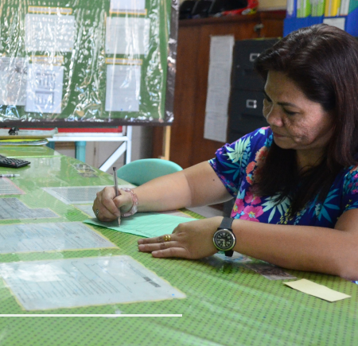

Microfinance and Sustainable Finance for the Poor
Dr. Jaime Aristotle B. Alip
“Sustainability must include the poor.”

Slide 2
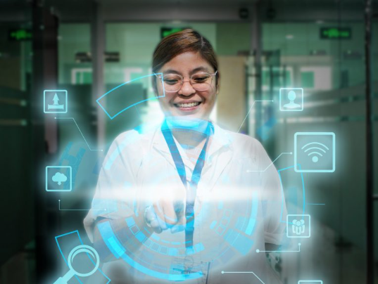
The Expanding Role of MFIs
From Microfinance to Sustainable Finance
MFIs are not just financial service providers—they are enablers of resilience.
Sustainable finance must be grounded in community realities.
Climate action, livelihood recovery, and digital inclusion are now core to our work.

Slide 3
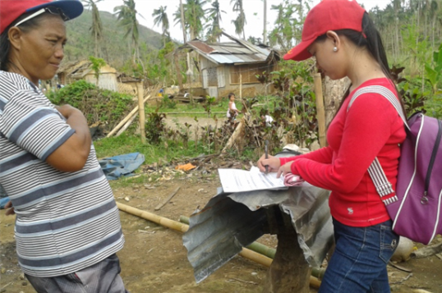
ESG Must Work for the Poor
From Microfinance to Sustainable Finance
Environmental: Supporting climate-resilient livelihoods
Social: Building social capital through inclusive finance
Governance: Grounding operations in trust, transparency, and client focus
“Let us push for a sustainability agenda that does not exclude the poor.”

Slide 4
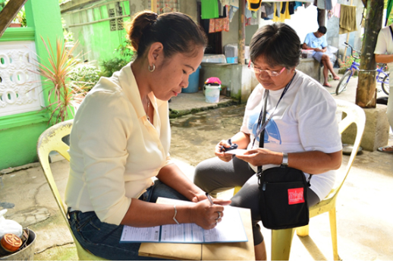
Real Faces of Sustainable Finance
Sustainability in Action
Woman in Surigao with microinsurance
Sari-sari store owner rebuilding after the typhoon
Coconut farmer in Basilan practicing regenerative agriculture
“This is sustainable finance—and we are already doing it.”

Slide 5
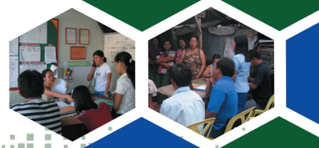
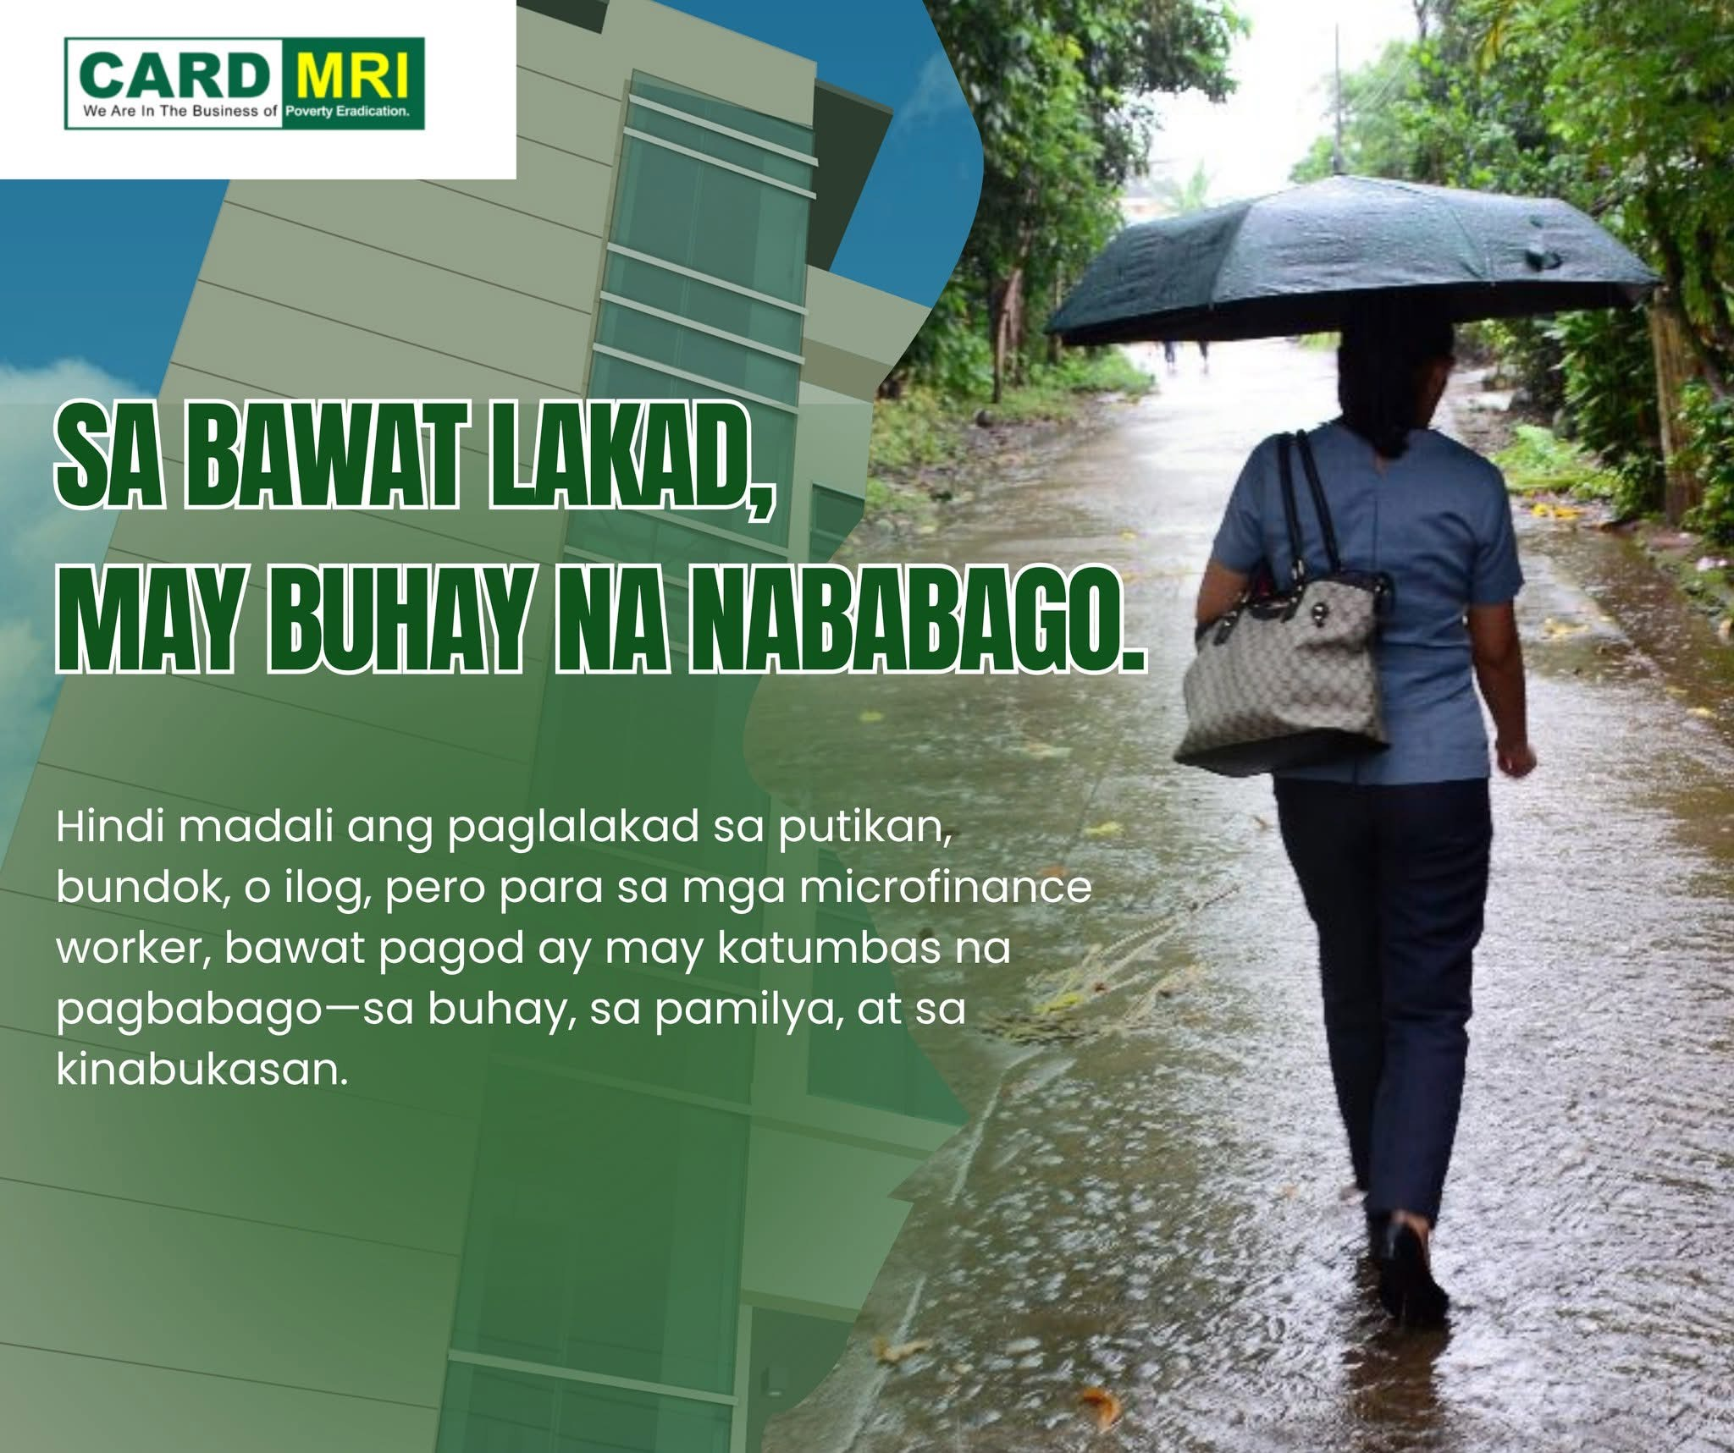
Tribute to MFI Staff
Our Frontline Heroes
Operations and field staff implement sustainable development every day
They are community builders, not just loan officers
Their knowledge, compassion, and trust relationships are our greatest assets

Slide 6
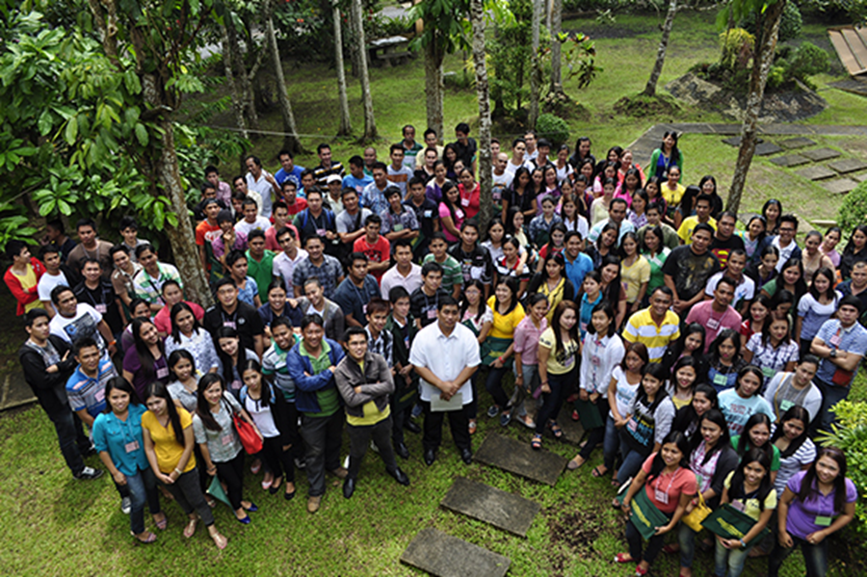
A Call to Action
The Road Ahead for Inclusive, Sustainable Finance
Shape ESG frameworks that recognize the poor
Promote social impact alongside financial returns
Build institutions that are morally grounded and community-centered
“Let us open doors, build bridges, and transform lives—together.”

Slide 7
Thank You!!!

